Slide 1








BYJU’S
PW
ATTENDENZA
UDEMY
UNACADEMY

Slide 2



….Every day counts
VERSION 1.0.0

Slide 3






ADMIN LOGIN
STUDENT LOGIN

Slide 4
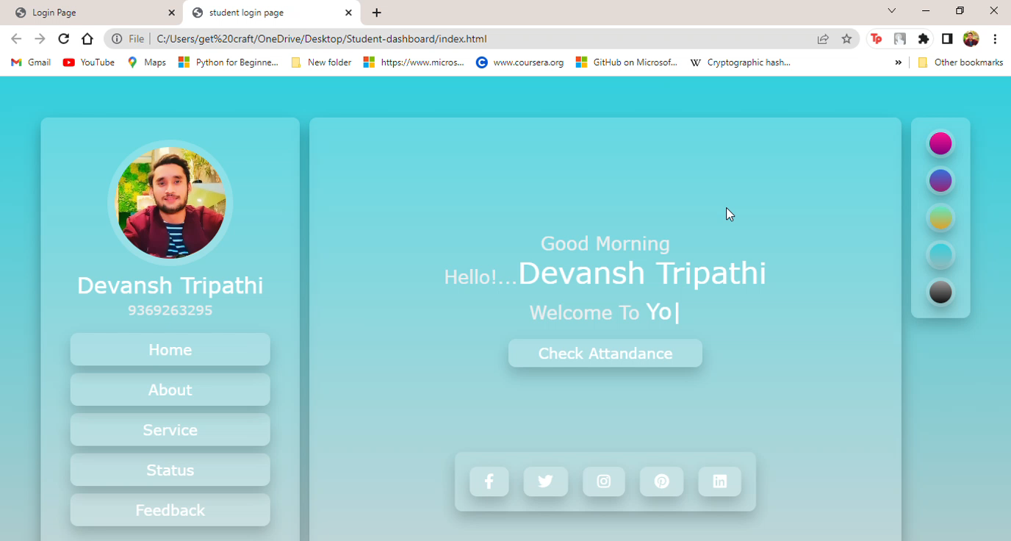

Slide 5

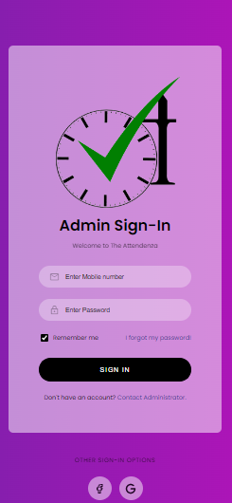
DATA SECURITY

Slide 6
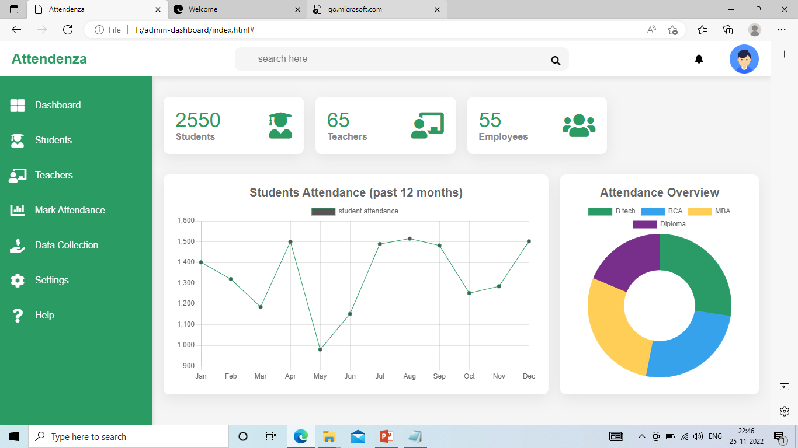
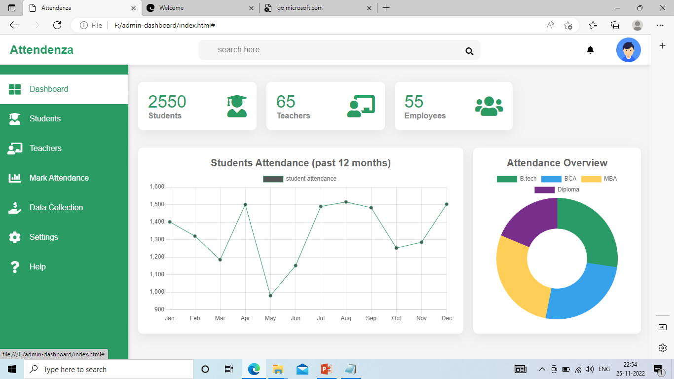

USER-FRIENDLY
ECONOMICAL
CALCULATIVE
DESCRIPTIVE

Slide 7


FEATURES
ECONOMICAL
PORTABLE
SIMPLIFY THE CALCULATIONS
TRANSPARENCY

Slide 8
THANK YOU!!!

